Slide 1

Lecture – 5 Method and Method Overloading
Afsara Tasneem Misha
Lecturer
Department of CSE
Daffodil International University

Slide 2
Contents
Method in Java
Method Overloading

Slide 3
Topic – 1: Methods in Java

Slide 4
Java Methods
Java Method is a collection of statements that are grouped together to perform a specific task.
A method must be declared within a class.

Slide 5
Types of Methods:
In Java, there are two types of methods:
Standard Library Methods: These are built-in methods in Java that are available to use. Such as, print(), nextInt(), sqrt() and many more
User-defined Methods: We can create our own method based on our requirements.

Slide 6
Syntax of Defining a function
modifier return_type methode_name (parameter list)
{
// body of the method
}

Slide 7
Here,
Modifier: it defines the access type of the method
Return_type: specifies the type of data returned by the method
Methode_name: name of the method
Parameter_list: list of parameters. It is the type, order and number of parameters of the method
Body_of_method: defines what the method does

Slide 8
Categories of User-Defined Methods:
For better understanding of arguments and return type in methods, user-defined methods can be categorized as:
1. Method with no arguments and no return value
2. Method with arguments but no return value
3. Method with no arguments but with return value
4. Method with arguments and return value.

Slide 9
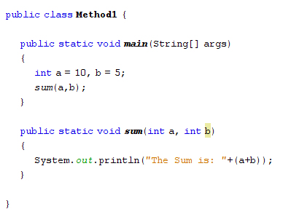
Example -1: Add two integer values using method

Slide 10
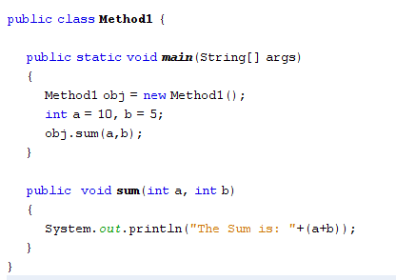
A method is always invoked with respect to an object.

Slide 11
Example- 2:
Define a method called max(). This method takes two parameters num1 and num2 and returns the maximum between the two.
Try yourself!

Slide 12
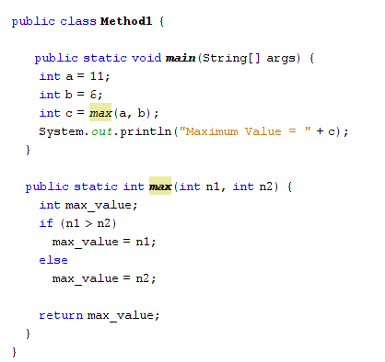
Solution 1: *Without using object If we want to call any method without any object, then we have to declare the method as static.

Slide 13
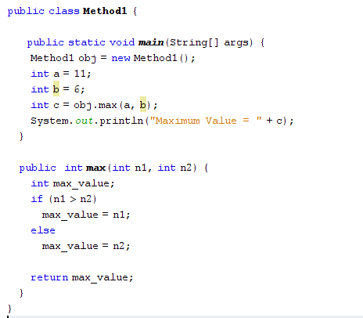
Solution 2:
*Using object

Slide 14
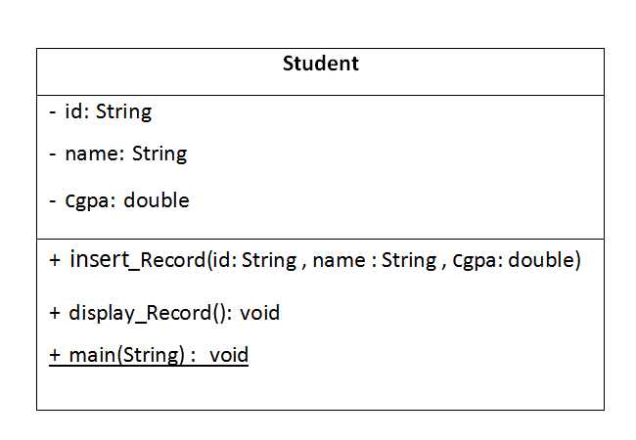
Example-3 : Convert this UML to Java Code

Slide 15
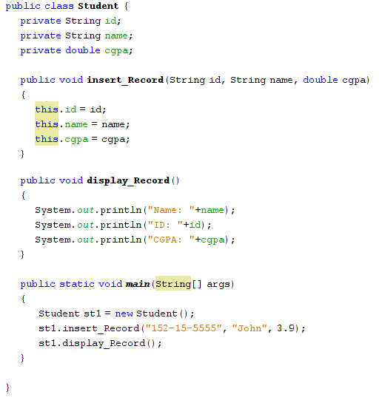
Solution

Slide 16
Visit the links for more details:
https://www.javatpoint.com/method-in-java
https://www.tutorialspoint.com/java/java_methods.htm
https://www.w3schools.com/java/java_methods.asp

Slide 17
Method Overloading
Topic – 2: Method Overloading in Java

Slide 18
Try?
Write a program that will add two integer numbers, and three integer numbers using two different methods and display two result.
Write a program that will add two integer numbers, and two double numbers two different methods and display two result.

Slide 19
Method Overloading
When a class has two or more methods by same name but different parameters, it is known as method overloading.
Method overloading increases the readability of the program.

Slide 20
Different ways to overload the method
There are two ways to overload the method in java
By changing number of arguments
By changing the data type

Slide 21
1. By changing number of arguments
public class MethodOverloading {
void sum(int a, int b)
{
System.out.println(a+b);
}
void sum(int a, int b, int c)
{
System.out.println(a+b+c);
}
public static void main(String args[]){
MethodOverloading obj = new MethodOverloading();
obj.sum(20,20);
obj.sum(10,20,30);
}
}
In this example, we have created two overloaded methods, first sum method performs addition of two numbers and second sum method performs addition of three numbers.

Slide 22
2. By changing data type of argument
public class MethodOverloading2 {
void sum(int a,int b)
{
System.out.println(a+b);
}
void sum(double a, double b)
{
System.out.println(a+b);
}
public static void main(String args[]){
MethodOverloading2 obj=new MethodOverloading2();
obj.sum(10.5,10.5);
obj.sum(20,20);
}
}
In this example, we have created two overloaded methods that differs in data type. The first sum method receives two integer arguments and second sum method receives two double arguments.

Slide 23
Exercise – 1
Find out the maximum value between two integer numbers, three integer numbers and two double numbers.

Slide 24

Thank you!

